Slide 1


SMART INDIA HACKATHON 2026
Problem Statement ID – SIH26107
Problem Statement Title- Al-powered Intelligent Assistant for Indian Standards and BIS Services for Industries and Consumers
Theme- Smart Automation
PS Category- Software
Team ID-
Team Name- STROPHOID

Slide 2

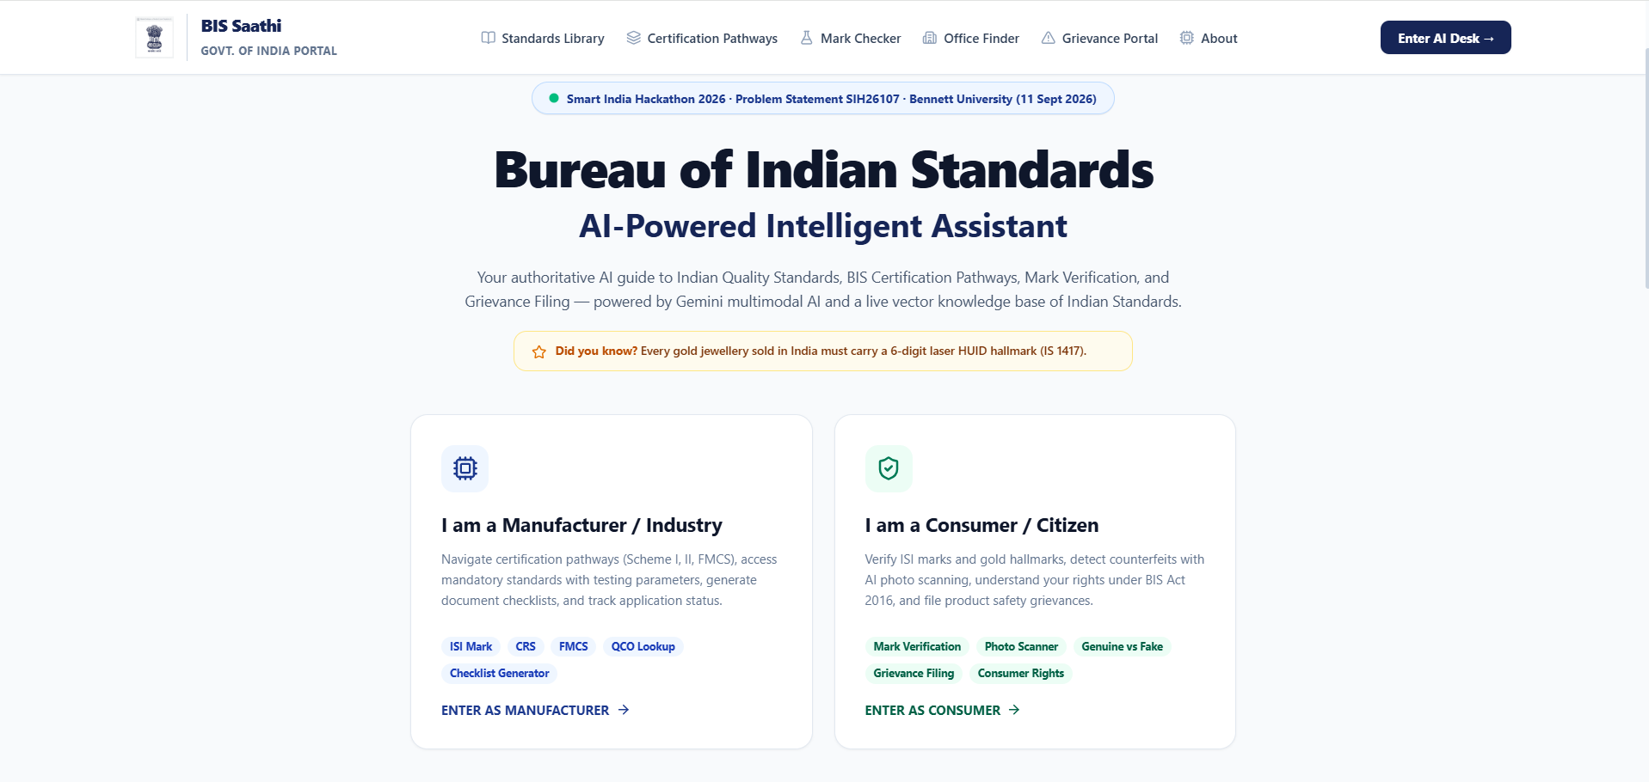
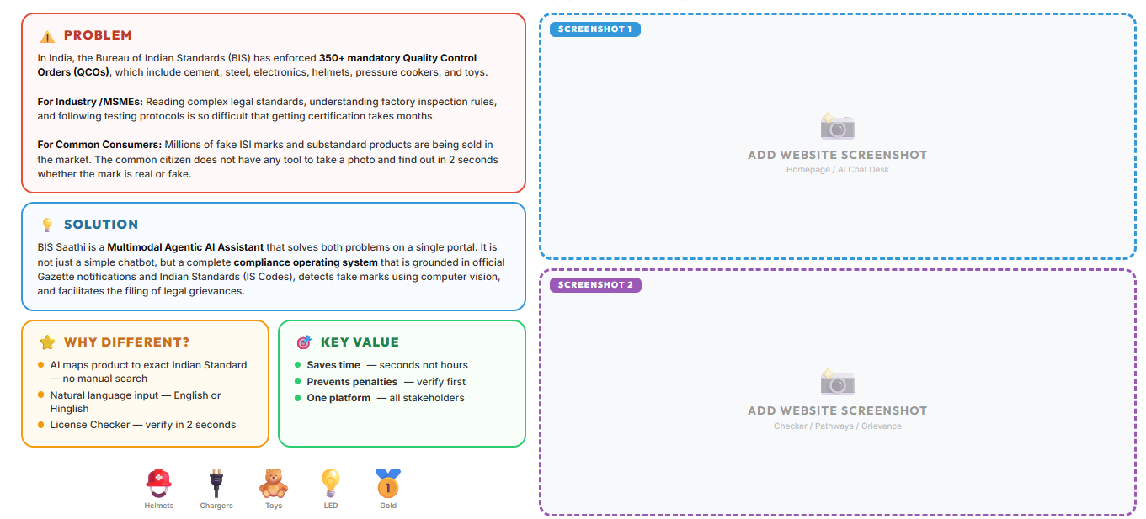
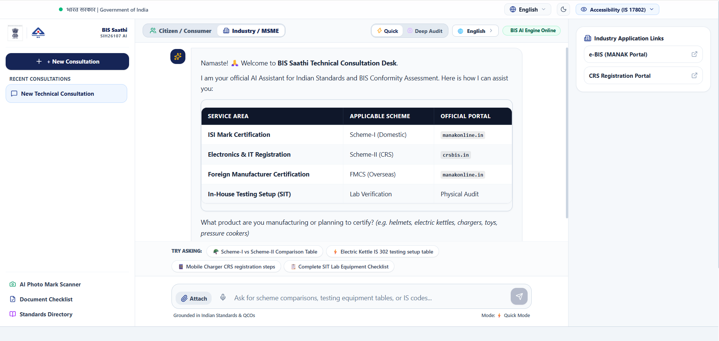
BIS ai-Saathi
Strophoid
“Your AI Guide to Indian Standards & BIS Certification”

Slide 3

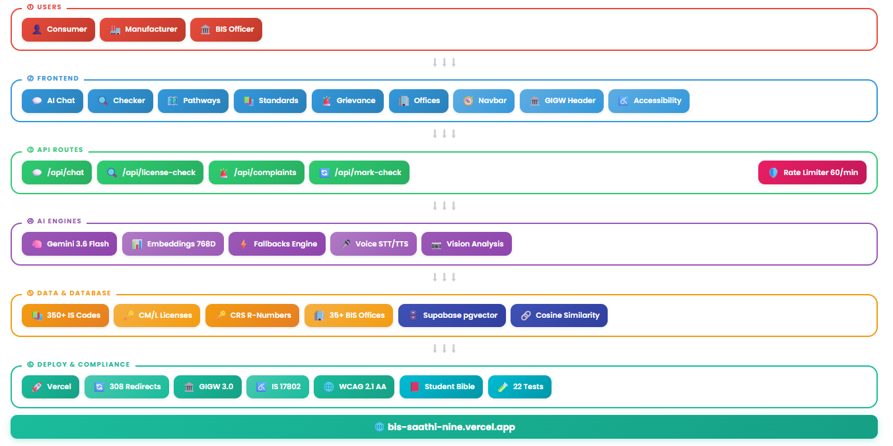
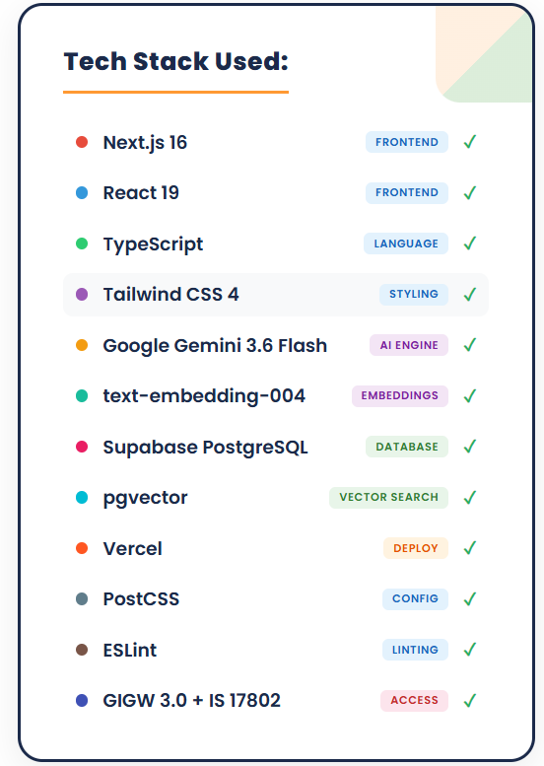
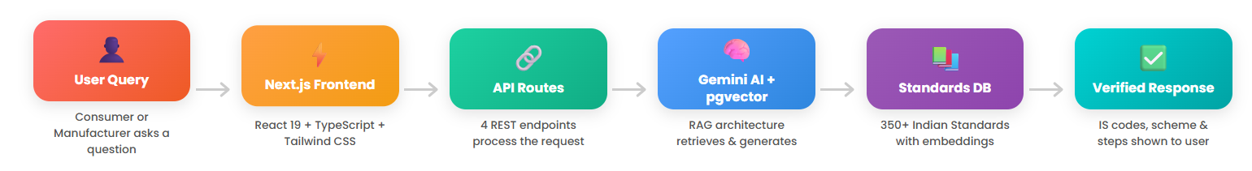
TECHNICAL APPROACH
----------- System Architecture ------------
|---------------------------- Process Flowchart -----------------------------|

Slide 4
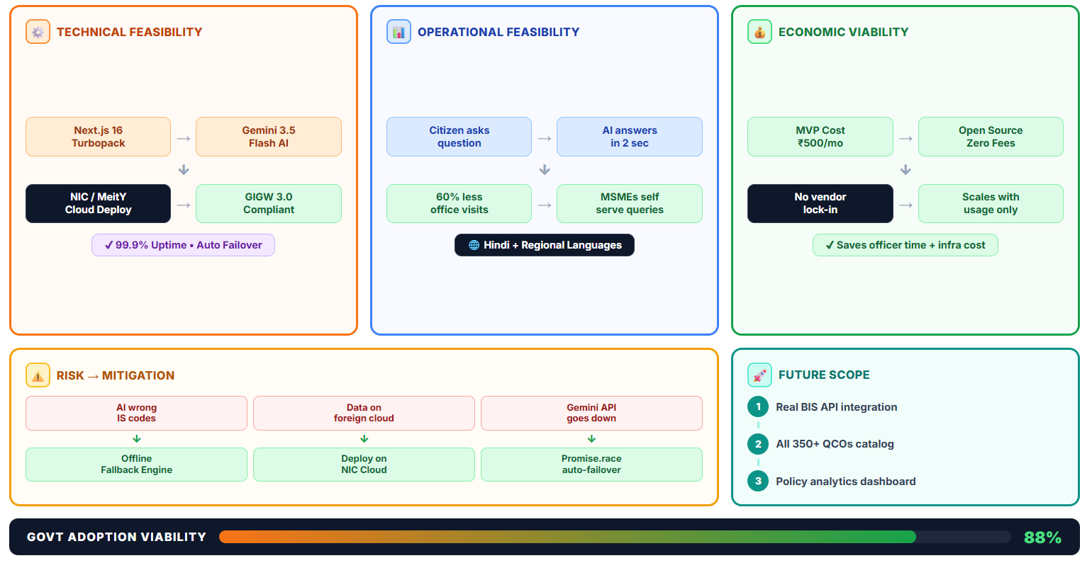
FEASIBILITY AND VIABILITY

Slide 5
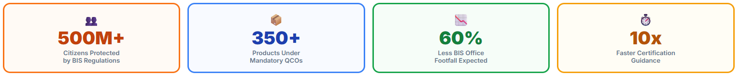
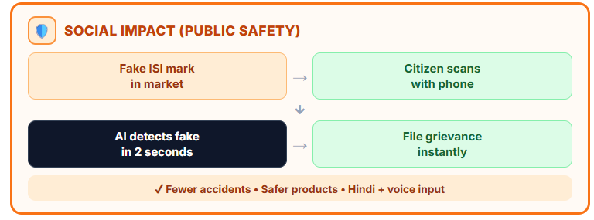
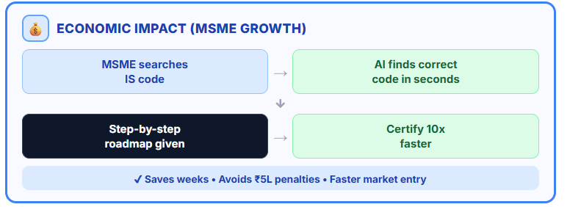
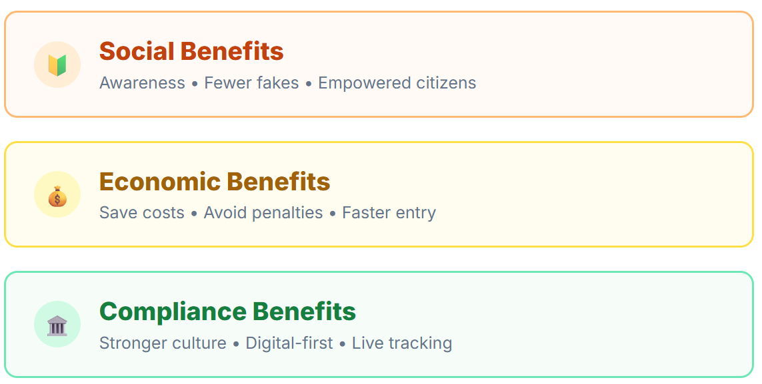
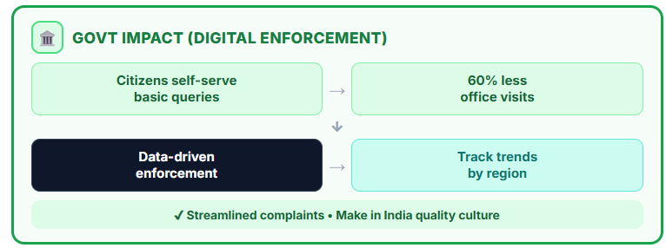
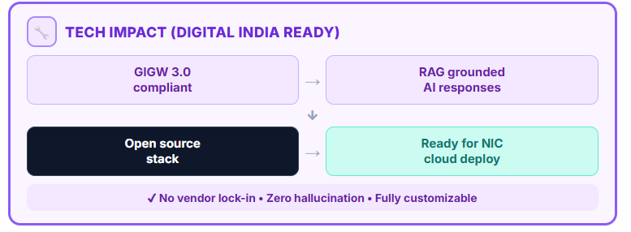
IMPACT AND BENEFITS
-------------------- What Happens When Government Adopts BIS AI Saathi-------------------------

Slide 6
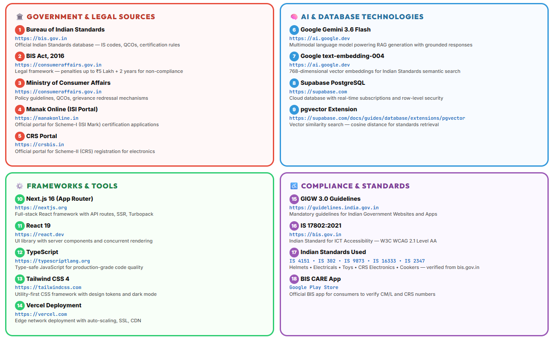
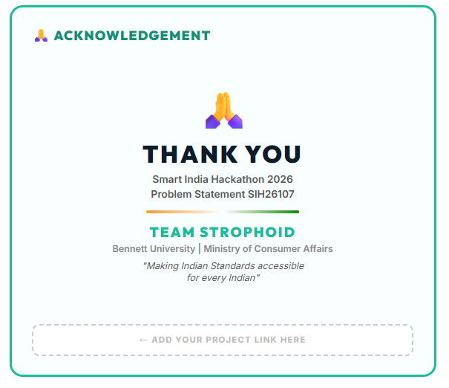
RESEARCH AND REFERENCES
https://bis-saathi-nine.vercel.app/

